Slide 1
Propulsion Requirements for Future Generation Space Habitats
Kenneth J MacLeod, member spst
Dr. James A Martin, Boeing (retired), member spst
AIAA Propulsion and Energy Conference, August 21, 2019

Slide 2
The Questions
How can we develop a new generation of space habitats with strong rotational gravity and substantial shielding from cosmic radiation, to keep crews healthy for over 2 years?
How can we keep them light enough to transfer to key locations such as lunar orbit or Mars orbit?
What propulsion will be required to transfer them after construction in low Earth orbit?

Slide 3
Locations for Transfer Requirements
Space habitats may be needed at:
  Low Earth orbit
  Lagrange points
  Lunar orbit
  Mars orbit
  Aldrin Earth-Mars cycler
  Accompanying an asteroid or comet
  But habitats can be economically assembled only in low Earth orbit
  (Or potentially in Lunar orbit, with efficient transfer of elements by SEP)

Slide 4
Transfer Velocity Requirements
Transfer Velocity requirements for key locations:
  Low Earth orbit to Lunar orbit
    For high acceleration: 4.04 kilometers per second
    For low acceleration, without Oberth effect: 8.0 km/s
  Low Earth orbit to Mars orbit
    For high acceleration: 6.6 km/s
    For low acceleration: estimated up to 13.0 km/s

Slide 5
New Results Drive New Requirements
For decades, global space powers have made two key bets:
People will be OK for years in space in 0 G
  With countermeasures such as some exercise and calcium supplements
People will be OK for years in space with little shielding from cosmic radiation
  With countermeasures such as more sleep and antioxidant supplements
This year, it became clear we have lost those bets:
  In April, the final report of the Kelly twins study showed 0 G and radiation problems after one year were serious, including cognitive reduction
  In August, the first report of the new radiation test lab at Colorado State U showed unexpected reduction of responsiveness of hippocampus, and significant cognitive reduction in mice after 6 months of irradiation

Slide 6
Next Generation Space Habitats
Key requirements for next generation:
  Crews maintained healthy for 2 years or more
  Rotational gravity of 1 G or possibly 0.75 G
    Lower G levels too risky until clear human test results
  Shielding to reduce cosmic radiation to 1/5 unshielded rate
    Dosage after 2 year mission equivalent to 4.8 months unshielded
  Strong redundancy to manage early system failures
  Initial maximum 5,000 ton mass for launcher limits
  Notional crew size: 16 to 32 people, expandable to 100+

Slide 7
Previous Habitat Concepts with Rotational Gravity
Consider four previous habitat concepts with rotational gravity:
  Space Wheel of Wernher von Braun, 1956
  Stanford Torus, 1975
  Gerard O'Neill cylinders, 1976
  Nautilus-x of Mark Holderman and Edward Henderson at NASA, 2011
The first three are all based on very large monolithic habitable volumes.
They are out of reach for the foreseeable future due to excessive mass and difficulty of assembling in space from thousands of curved pieces.
The Nautilus-x is more practical in scale, but faces other challenges.

Slide 8
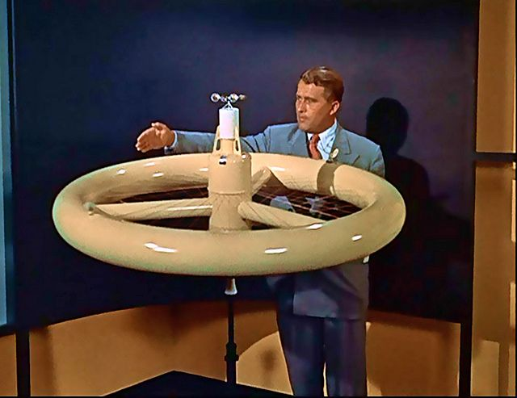
Von Braun
Space Wheel
Proposals from 76 meter diameter to 2 km diameter.
Larger versions have estimated mass in the 5 million ton range.
All versions require complicated construction in space
Large monolithic pressurized volume must be completed, tested, and filled with atmosphere before first residents move in

Slide 9

Stanford Torus
Diameter of 1.8 km
Habitat for 10,000 people
Mass of 10 million tons
Rotates at 1 rpm
Shielding by 1.7 meters of lunar soil

Slide 10

O’Neill Cylinders
Dual contra-rotating cylinders to suppress gyroscopic effects
Each cylinder length 32 km (20 miles)
Diameters of 6.4 km (4 miles)
Half-density atmosphere
Atmosphere mass over 1.2 billion tons
Material launched from Moon or asteroids by mass driver – estimate 5 billion tons

Slide 11
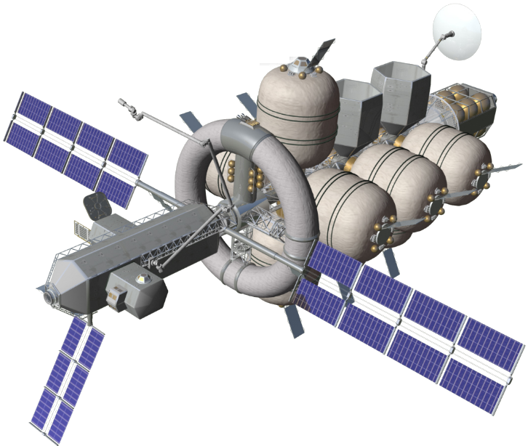
NASA Nautilus-x
More practical scale
Centrifuge is est 15m major diameter and 3m minor diam
But other challenges:
Sealing the continuously rotating joints
Small diameter and rapid rotation may result in nausea for residents
Most of the pressurized volume is in 0 G

Slide 12
Responding to the Challenge with a Modular Ring Habitat, the ModRing
The ModRing employs these key design choices:
  Modular habitat volumes instead of monolithic pressurized volume
  Sparse ring construction, somewhat like the London Eye
  Repetitive use of a few key types of elements
  Automated assembly by semi-autonomous assembly tugs
  Radiation shielding by polyethylene pellets in double-wall compartments
  Extensive redundancy for safety
  Initially, choose 1 G and 30-second rotation period, for low risk of nausea
  This example has 8+2 habitation modules, for a crew of about 32 people

Slide 13
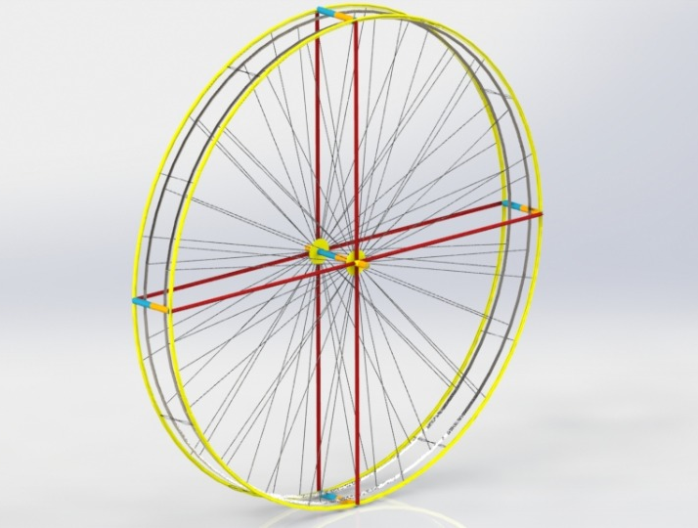
The ModRing Habitat
Sized for full 1 G gravity at 30 second rotation period
Initial configuration
Four pairs of habitation modules plus hub pair
Crew of 32, at 4 per module
500 meters diameter

Slide 14
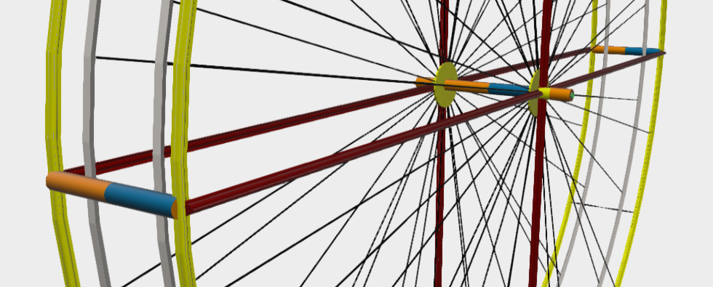
Closer View of ModRing
Dual structural rings and dual perimeter access tubes, assembled from 25-meter straight elements.
Clearer view of hub, with dual docking ports and dual sets of radial access tubes with elevators.

Slide 15
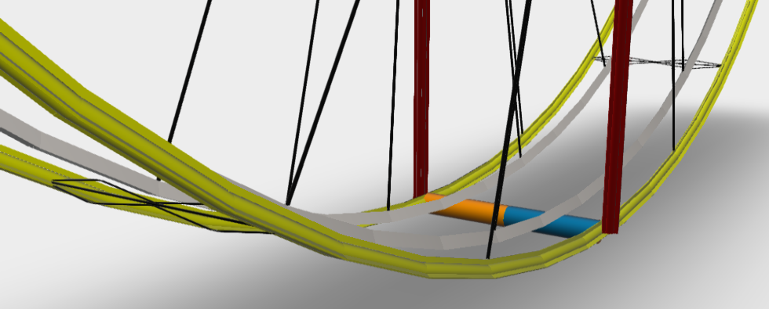
Pair of Habitation Modules (Down is Down!)
Showing dual radial access tubes (red) with electric elevators,
and dual perimeter access tubes (yellow) with electric shuttles

Slide 16
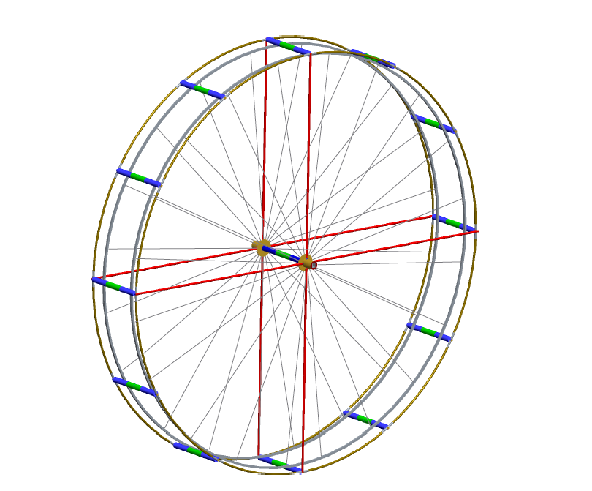
Growth Example to 36+3 Modules
Triple habitation modules at 12 locations around the ring.
Crew of 144, at same density of 4 crew per module.
Same diameter, access tubes, structural rings, docking bays and ports.
Additional tension cables, and strengthened hub rings.

Slide 17
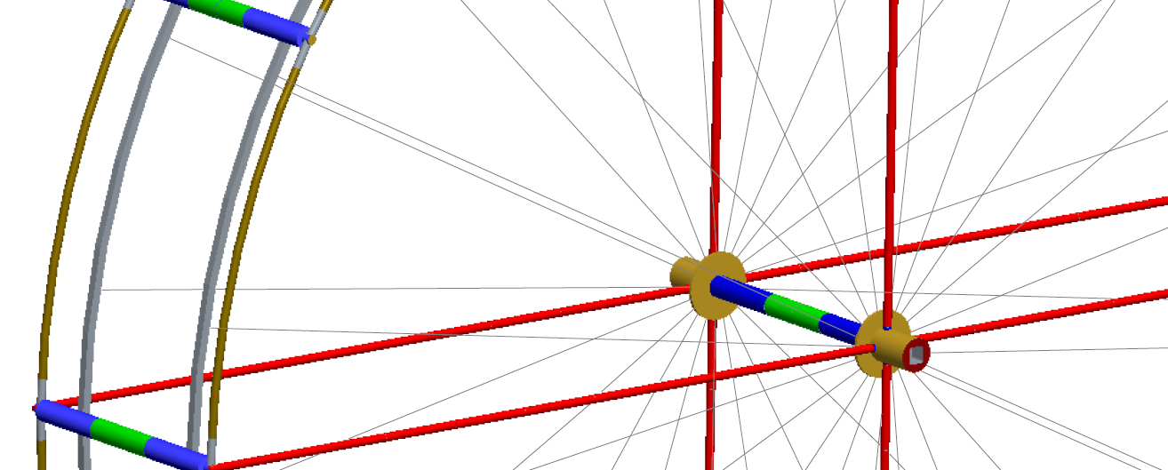
Closer View of Growth ModRing
Triples of habitation modules instead of pairs
Clearer view of hub, retaining most of the same components

Slide 18
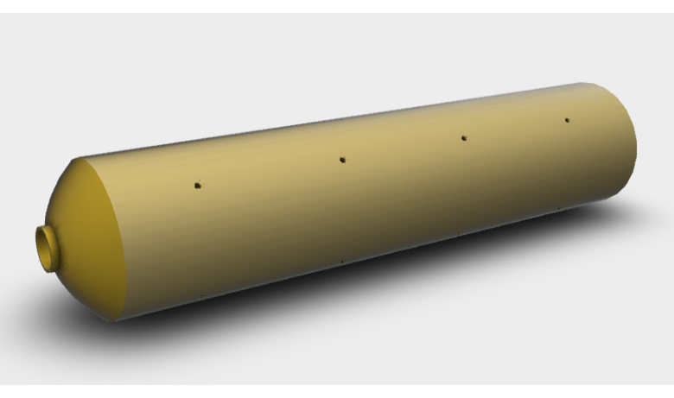
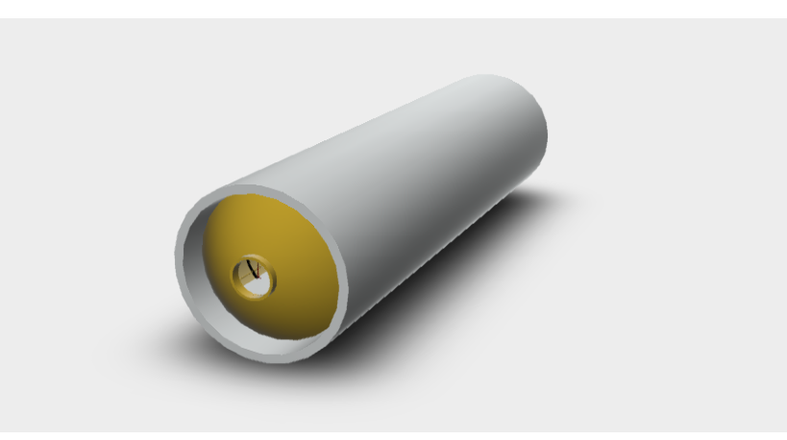
Habitat Module, and Module in Fairing
Module 6.2 meter diameter X 25 meter length
Fill holes shown for shielding pellets
Fairing 7 meter diameter X 25 meter length
Holds single habitat module for launch

Slide 19
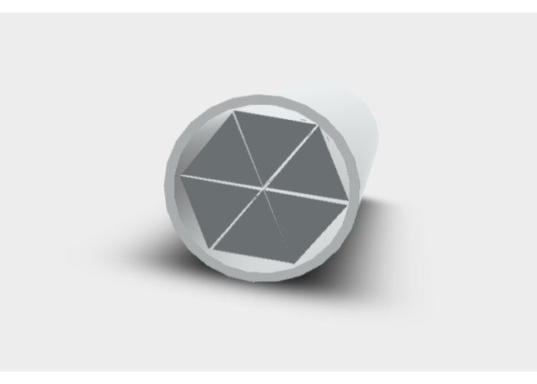
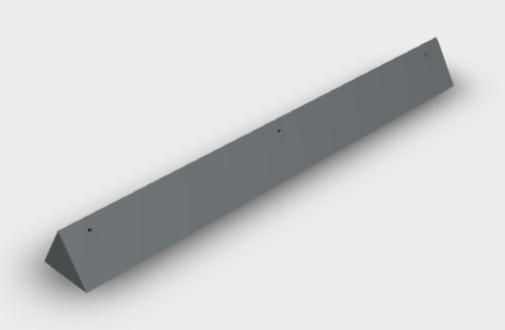
Structural Ring Element
And Six Elements in Fairing
3 meter width faces X 25 meter length
Attachment holes shown for tension cables
Fairing 7 meter diameter X 25 meter length Holds 6 elements for launch

Slide 20
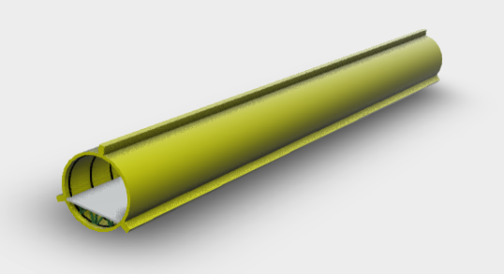
Perimeter Access Ring Element
2.6 meter diameter X 25 meter length
Ribs for stiffness
Road floor for electric shuttles or jogging
Ends are cut at 3 degree angle to form ring of 60 elements

Slide 21
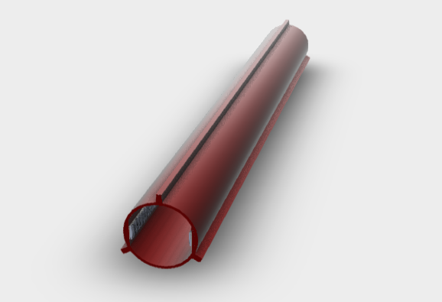
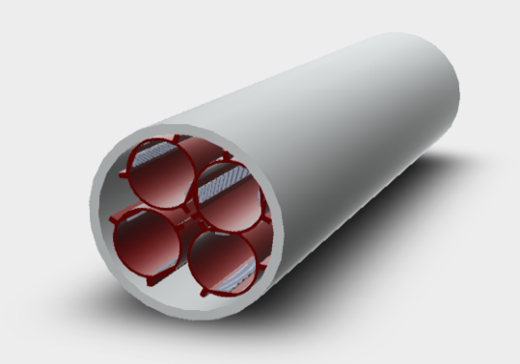
Radial Access Tube Element
And Four Elements in Fairing
2.6 meter diameter X 25 meter length
Dual internal linear gears for electric elevator
Fairing 7 meters diameter X 25 meters length
Holds 4 access tube elements for launch

Slide 22
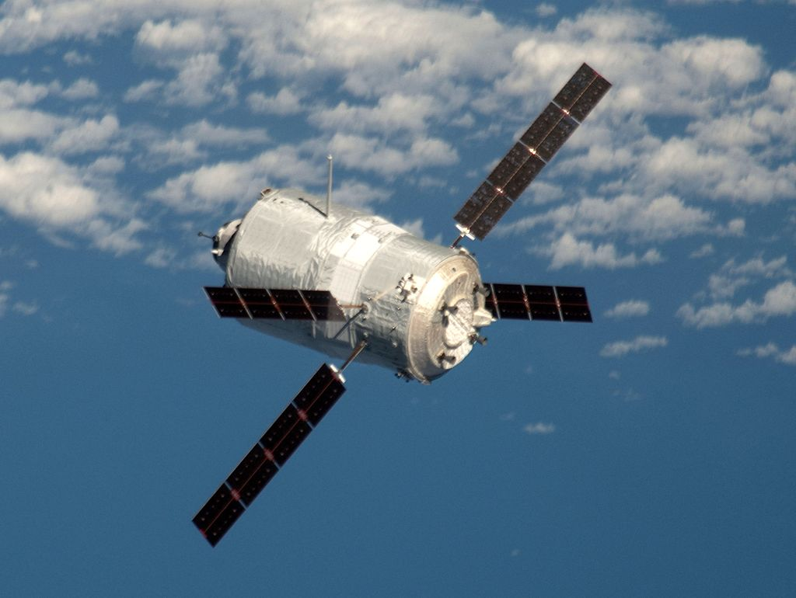
Assembly Tug Semi-Autonomous Spacecraft
Three tugs and a ‘Tool Shed’ are launched first.
The Tool Shed has a few complex tools for connecting each type of element. As each payload approaches, the tugs select proper tools from the Tool shed.
Tugs meet each arriving payload, grapple it, and attach elements to the ring.
Standardizing a few types of modules and automating assembly are crucial for enabling such a large sparse structure.
(ESA ATV-3 shown for concept)

Slide 23
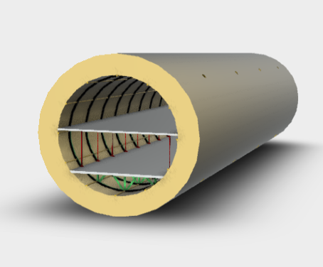
Double Walls for Shielding Pellets
Double walls provide 0.8 meter depth compartments for shielding pellets
Pellets are polyethylene spheres, perhaps 80 mm diameter.
Random packing produces 0.63 density of pellets, for effective shielding depth of 0.5 meters.
Pellets are loaded through fill holes shown, by assembly tug using nozzle tool.

Slide 24
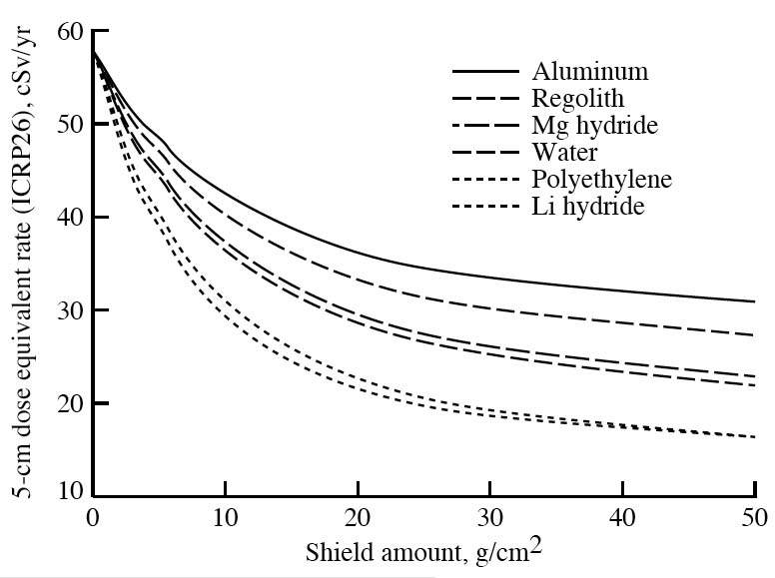
Polyethylene Shielding
Deployed around US sleeping berths on ISS
Standard for US Navy nuclear submarines and ships for decades
Lightest choice of materials, but still 203 tons per module
Reduces cosmic radiation dose rate to 1/5 of unshielded rate, including structure and equipment
Chart from NASA Radiation Protection guide, Simonsen et al, reprinted by Rapp 2006

Slide 25
Compact ModRing with 0.75 G
Baseline ModRing above has 1 G and 30 second period of revolution for high confidence of maintaining crew health for more than 2 years, with little nausea from Coriolis.
Much more compact ModRing can be built if slightly more risk accepted.
For example, a ModRing with 0.75 G rotational gravity, and a rotational period of 0.75 times the baseline, or 22.5 seconds, leads to:
  Diameter of 191 meters instead of nearly 500 meters
  Each structural ring has 24 segments instead of 60
  Each perimeter access ring has 24 segments instead of 60
  Mass of 2,500 tons for configuration of 4 + 2 habitation modules

Slide 26
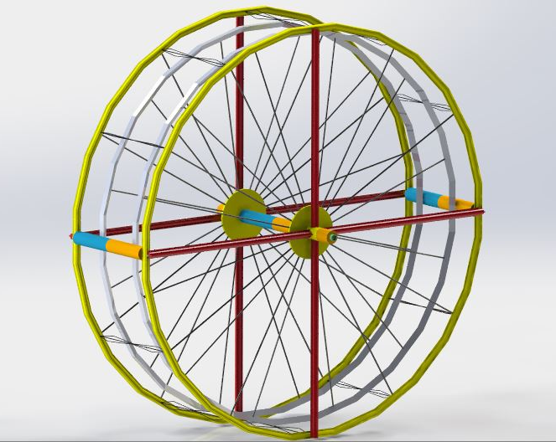
Compact ModRing24 with
4 + 2 Modules
Dual habitation modules at 2 locations around the ring.
Crew of 16, at same density of 4 crew per module.
Smaller diameter, so access tubes, structural rings, each have 24 straight elements.
Fewer tension cables, and lightened hub rings.

Slide 27
Propulsion Alternatives for Transfer of ModRing to Lunar and Mars Orbits
All chemical rocket transfer stages are impracticably large
  Required mass ratios lead to stages more massive than ModRing
  No launchers available or planned could orbit such large stages
Nuclear thermal and solar thermal offer higher Isp
  Thermal transfer stages still too massive for any planned launcher
Solar Electric Propulsion, SEP, and Nuclear Electric Propulsion, NEP
  Both offer the highest Isp’s from very high exhaust velocity
  These are the only potential choices

Slide 28
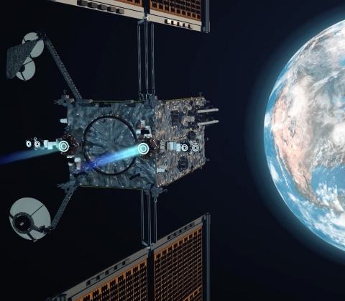
Example Electric Propulsion Stage: Maxar PPE
Maxar Power and Propulsion Element (PPE) for Lunar Gateway
Solar array of 50+ kW
Thrust of 2.4 newtons from 4 Hall thrusters of 0.6 newtons each
Uses best current technology

Slide 29
Conceptual Electric Propulsion Stage
We consider a 2 MW solar array to be near the maximum credible power
  8 times larger than ISS array of 250 kW
Likewise, 2 MW is very large for a space nuclear electric generator
Scaling up the technology of the Maxar PPE for the Lunar Gateway:
  Power scales up from 50+ kW to 2 MW
  Number of Hall thrusters scales up from 4 to 150
  Thrust scales up from 2.4 newtons to 90 newtons

Slide 30
Transit Times for ModRing to
Lunar and Mars Orbits
Baseline ModRing at 5,000 tons:
  SEP or NEP run time of 14.1 years for lunar transfer or 22.9 years for Mars transfer
Compact ModRing at 2,500 tons:
  SEP or NEP run time of 7.05 years for lunar transfer or 11.45 years for Mars transfer
Compact ModRing with shielding pellets sent separately, at 1,300 tons:
  SEP or NEP run time of 3.7 years for lunar transfer or 6.0 years for Mars transfer
  The run times above do not account for the added mass of the transfer stage

Slide 31
Conclusions
Next generation space habitats will require near 1 G rotational gravity and substantial shielding from cosmic radiation, in order to keep crews healthy for more than 2 years.
Previous habitat concepts with those capabilities have been far too massive and difficult to construct, or limited by other unresolved challenges.
The Modular Ring or ModRing concept presents the first practical habitat with near 1 G rotational gravity and substantial shielding from cosmic radiation, by employing six key design choices to achieve this objective.
Even at these more practical masses of 1,300 to 5,000 tons, the duration required to transfer them from low Earth orbit to lunar orbit or Mars orbit is only marginally practical. Durations range from 3.7 years to 22.9 years.

Slide 32
Thank You!
Thanks to Faizan muhammad, Doug MacLeod, Dwight Soell, and Gus Calderon for the modring CAD models and images

