Slide 1
Commemorate the 50th Anniversary of the Apollo 11 Moon Landing
(The Apollo 11 Plus 50 Project)
52th AIAA/ASME/SAE/ASEE Joint Propulsion Conference
25 – 27 July 2016, Salt Lake City, Utah
Edward M. Henderson (ret.), NASA/JSC Space Shuttle Program, Advanced Studies,
Douglas G. Thorpe, Space Propulsion Synergy Team, Mt. Sterling, KY

Slide 2
What is the Apollo 11 plus 50 project
20 July 1969, Neil Armstrong & Buzz Aldrin became the first people to walk on another heavenly body, the moon.
Commemoration and recognition of this major technical accomplishment and it is to honor ~400,000 Americans and over 20,000 industrial firms & universities involved in America’s Manned Lunar Space Program
Every day we are losing people who participated or witnessed this event
The Countdown Clock is running, in 1,088 days (20July2019), we propose to kick off a series of lunar landings
To establish:
  Profitable commercial operations,
  Lunar colonies,
  A testing platform for missions to mars or other planets.

Slide 3
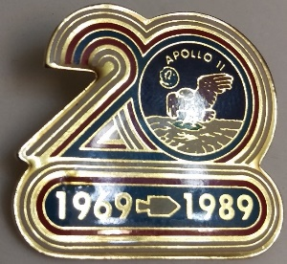
Initial Lunar Mission Considerations
1st mission needs to be a mission worthy of the event it’s commemorating.
  America spent $110 billion to accomplish the most difficult technological achievement of all time
  20 years later we celebrated the event by giving out $0.25 medallions
  How should we remember the 50th anniversary?
It should:
  Include lunar landing of some type & utilize advanced technologies that were not available 50 years ago
  Have a fixed target date corresponding to Apollo 11 landing date (July 20, 2019).
  Be affordable & sustainable
  Initiate a campaign of lunar missions
  Leverage commercial capabilities as much as possible.
  Demonstrate technologies that add value to ongoing commercial & exploration space activities.
  Mission planning should start immediately
  It should be a national commitment!

Slide 4
First Flight options/Objectives
50th anniversary of Apollo 11 flight < 3 years away - funding for project will not occur until the next fiscal year.
1st mission must be minimized to meet hard deadline & reasonable budget
We have derived 4 options for the first flight:
  Land an unmanned mobile video surveyor near an Apollo site, image hardware and demonstrate equipment and instruments needed to search for water/ice
  Land at polar region & initiate searchers for water/ice, explore lava tubes or other sources while demonstrating and evaluating the latest equipment
  Contract directly to commercial community to land on moon & exploit whatever is needed to find and process the lunar regolith for water.
  Extend Google X-Prize to add an Apollo anniversary flight

Slide 5
Issues
Who pays for it?
Who manages it?
How to integrate commercial and international partnerships?
How to protect proprietary rights?
How to make a national priority?
How to protect the Apollo site/hardware

Slide 6
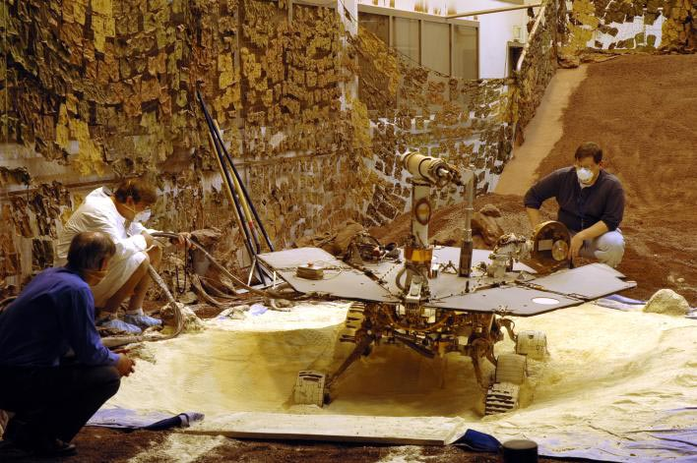
What’s needed
Launch Vehicle
Upper Stage
Lander
Rover
Power
Communication
Payload
Mission
Follow-on
  Our recommendation is to utilize the Mars Exploration Test Rover at JPL for Spirit & Opportunity which weigh 275 kg & is already built, fully tested, paid for.

Slide 7
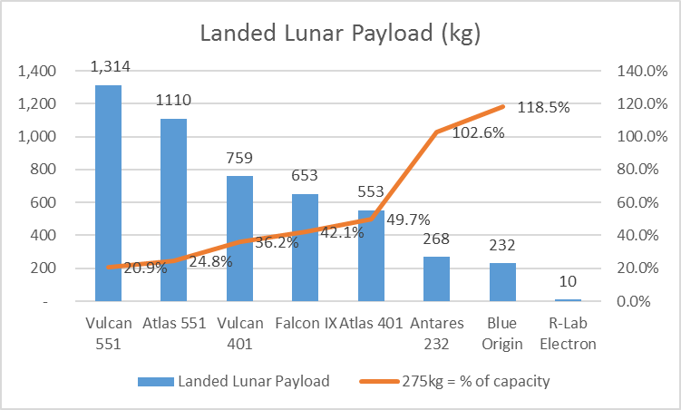
Potential launch vehicles

Slide 8
potential Lunar Landers

Slide 9
Potential Lunar rovers
As stated previously, we recommend using the Mars Exploration Test Rover, because it is already built, already tested, and already paid for.

Slide 10
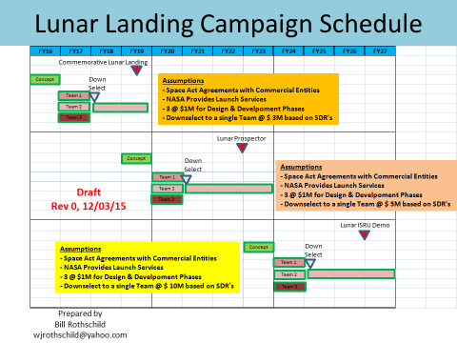

Slide 11
THE THIRD MISSION –
THE NEXT “MAN” (a walking robot) ON THE MOON
In the spirit of the Apollo program, this mission must accomplish the seemingly impossible.
Main objective is to demonstrate that a walking robot can operate on the lunar surface and perform tasks before humans arrive
  Survive the rigors of travel from the earth’s surface to the lunar surface (the new landing zone will be referred to as the plus 50 site)
  Transport a camera from the plus 50 landing site to a site that overlooks an Apollo 15 or Apollo 16 landing zone
  Set up the camera and other test equipment
  Transport a replacement battery to the lunar roving vehicle (LRV, aka, moon buggy) within the Apollo 15 or Apollo 16 landing area
  Remove & replace original, non-rechargeable silver zinc potassium hydroxide batteries
  Enter the driver’s seat of the LRV and drive to the plus 50 site. The walking robot may have 1, 2, 3, or more legs, but the LRV throttle and brake is controlled by hand levers.
  Collect and mount mobile solar panels to LRV
  Collect and mount lunar miner/chemical lab in passenger seat of LRV
  Drive LRV to pre-designated lunar sampling locations
  Position LRV mounted lunar miner/chemical lab over the sampling site and begin sample collection/analysis

Slide 12
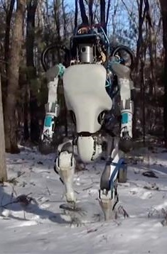
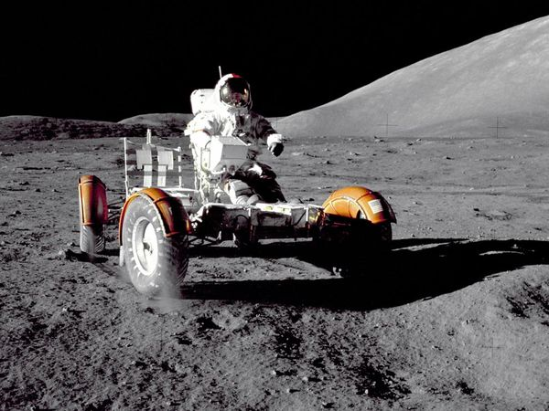
Why a Walking Robot; why the LRV
This mission will showcase the capability of the walking robot industry.
During the last two nuclear disasters,
  humans had to pick up or shovel extremely hot nuclear material off of a roof at Chernobyl and
  a nuclear accident could have been prevented at Fukushima, Japan if a robot could have walked across a room and turned a valve.
For 3rd mission, we are planning on sending a chemical analyzer that drills deep in to the lunar soil.
Rather than building a dedicated rover for the chemical analyzer/drill we could demonstrate state of the art for the walking robot while reducing weight and $ of transporting equipment to moon.
That is why the robot must drive back to the apollo11plus50 landing site; and load chemical analyzer/drill in the LRV passenger seat.

Slide 13
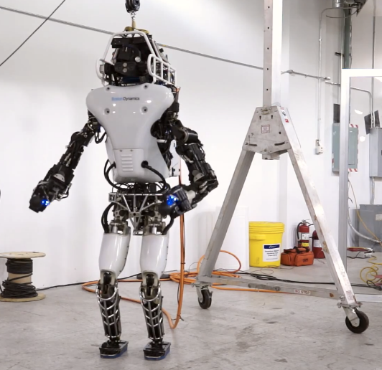
Why not send astronauts to do job
We were extremely lucky during the Apollo program, that a solar flare didn’t reduce any lunar EVA as a result of overexposure of our astronauts to solar radiation.
All of the lunar landings occurred during the height of Solar Cycle #20 with ~110 sunspots, but obviously few solar flares!
Astronauts need air, water, food, rest, shelter, and power;
Robots only need power!
A Robot could drive across the moon for 24 hours a day until a new moon occurred as there would be no solar power for the drill or LRV

Slide 14
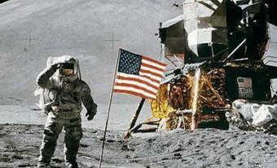
Conclusion:
Why is the Apollo 11 plus 50 project important
The Apollo 11 Plus 50 project is the chance of a lifetime to honor the many workers who dedicated their lives to accomplish the incredible feat of landing man on the moon in 1969.
Nothing will be more spectacular than to see a Walking Robot drive off in the distance on the moon with a bright earth in the back-ground.
While the world is watching, we will be stimulating our young people to study Science, Math & Engineering.
Please support the Apollo 11 plus 50 project by going to http://www.apollo11plus50.com/
And sign our petition to fund this project.

