Slide 1
Affordability Advantages in Integrating the Aircraft and Space Launch Operations – Part 2
AKA: The Hybrid Suborbital-Supersonic Aircraft
50th AIAA-JPC Conference, July 29, 2014
Cleveland, OH
All members:
Space Propulsion Synergy Team – http:spacepropulsion.org
Douglas G. Thorpe, Co-Founder: http://theUSAparty.com
Russel Rhodes: (ret) NASA-KSC, Florida
John Robinson: Propellant Supply Technology, Seal Beach, CA

Slide 2
Origin of Concept
Problems with Standard Air Launch Systems:
Difficulty of separating upper stage from airplane
Bottom Drop
Piggy Back
Back End
Subsonic aircraft requires larger rocket vs supersonic
Unusable payload capacity for fuel in airplane
Most aircraft reach cruise speed & altitude in 17 to 30 minutes, but flight can last 3.5 (Concorde) to 15.5 hours
232,000 lb of unrecoverable capacity in wings of AN-225
High cost of system if it is single purpose
White Knight
Pegasus
Peregrine Launch System

Slide 3
Notional Solution to Cheap Access to Space
Utilize Commercially Successful Supersonic passenger aircraft
Cost to modify aircraft a fraction vs develop single purpose
Airline market dwarfs space launch market
$5,000B vs $2B
642 million passengers on 8.9 million airline flights each year vs less than 543 to EVER go into space
ACMI costs for 747 size aircraft: $4,600 to $60,000/ flight hour
We estimated max total cost of $305,000 for aircraft usage
Once Aircraft is at cruise speed & altitude, utilize unrecoverable payload capacity to fuel liquid rocket engine & propel aircraft to high altitude & speed
For ETO Version: At max speed & altitude, eject rocket stage
For PTP Version: At max speed & altitude, guide as far as poss
If LOX can be produced in flight, greater range is possible

Slide 4
Baseline Aircraft & Modifications
Concorde as Baseline Aircraft System (but actual aircraft may resemble Valkyrie w/ engine pod hanging underneath).
Mach 2
60,000 ft altitude
410,000 lb gross weight
Concorde as a reference aircraft above
Concorde as a Space Truck below referred herein as HSA-ETO

Slide 5
Baseline Aircraft & Modifications
4 versions of Hybrid Sub-Orbital Supersonic Aircraft (HSA)
Reference aircraft – Concorde
3 Versions of Point-to-Point passenger Aircraft – HSA PTP
1 version for earth to Low Earth Orbit Aircraft – HSA ETO

Slide 6
Concorde vs HSA
HSA can fly overland since it flies too high to produce sonic boom
HSA flies faster than Concorde - should be able to charge premium
HSA fleet should be much larger than Concorde and so will be more than a novelty flight for a lucky few
Entire Concorde fleet flew less than two dozen flights/ week. Whereas, HSA fleet could have as many as 300 - 3,000 flights/day
Greater # flights will spread the development, unit, & maintenance costs of each flight
In Table below, PTP-HSA V2 vs Qantas Flight 7 (presently record holder for world’s longest non-stop flight)

Slide 7
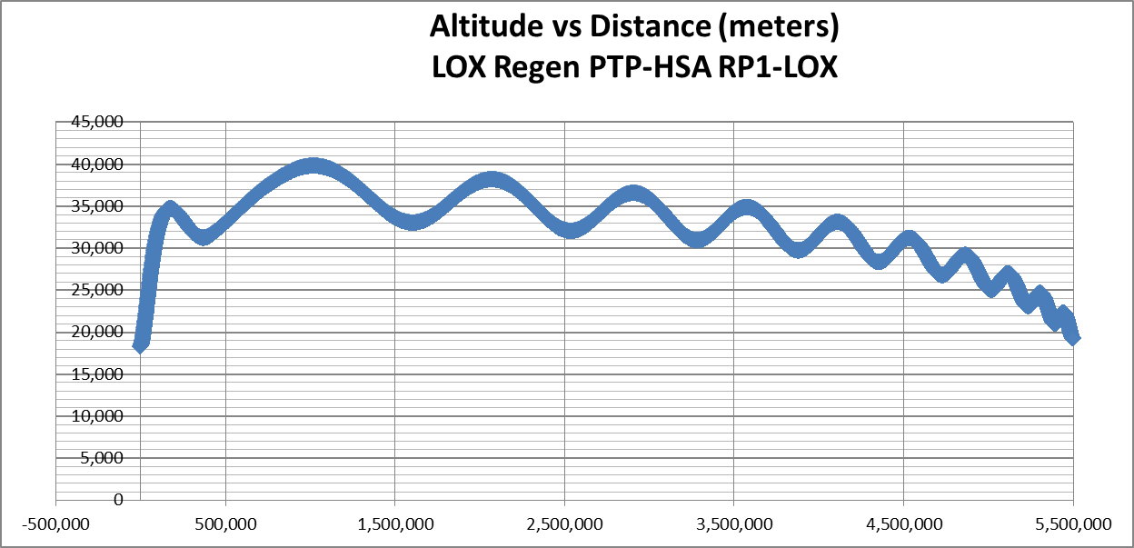
Point-To-Point Aircraft Flight Profile
P2P HSA Version 2 w/ 135 klb liquid methane fuel plus LOX regen under 40 km
Range = 5,500 km = 3,420 miles in 42 minutes of high speed flight!

Slide 8
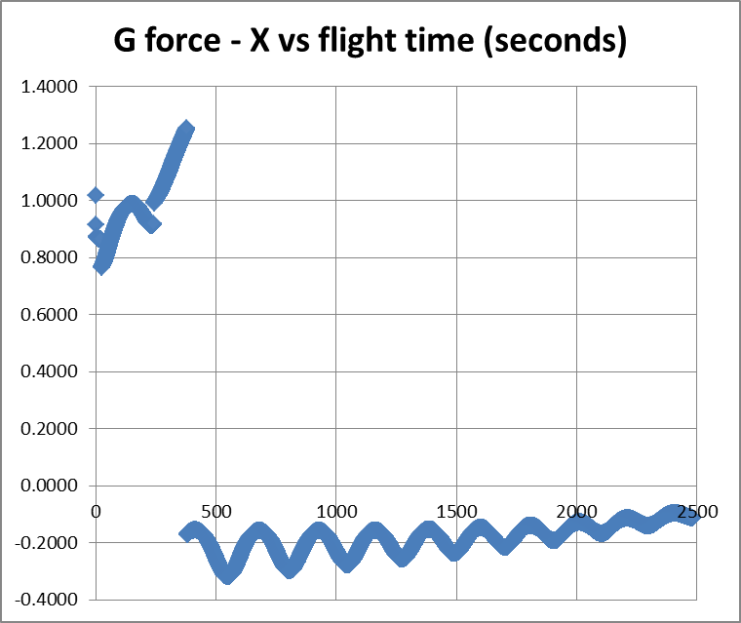
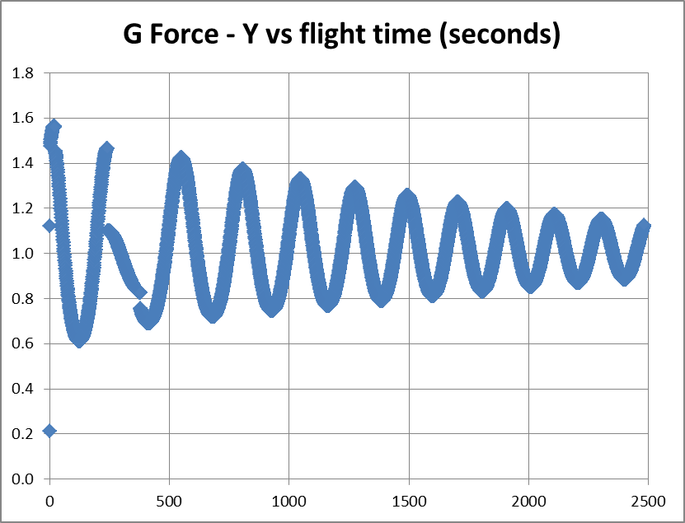
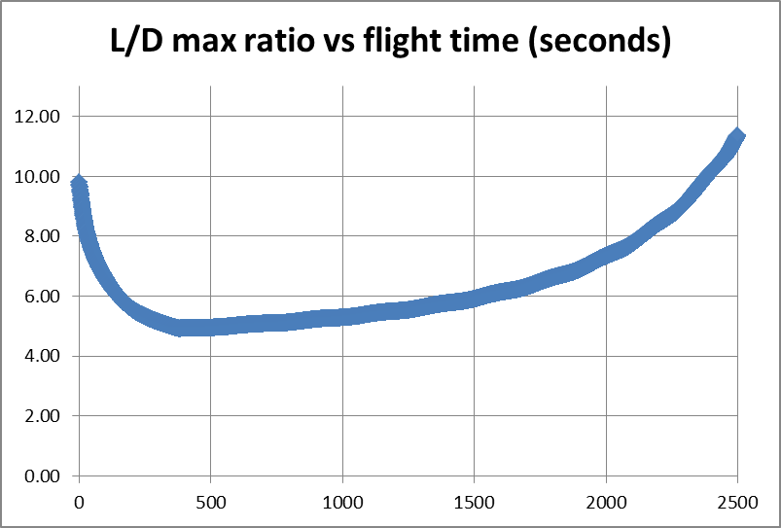
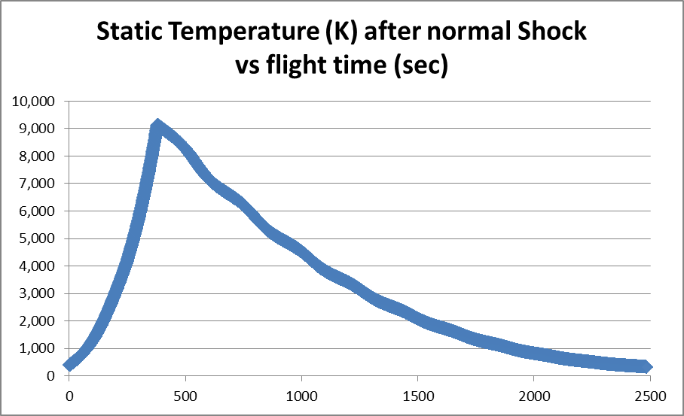
Point-To-Point Data

Slide 9
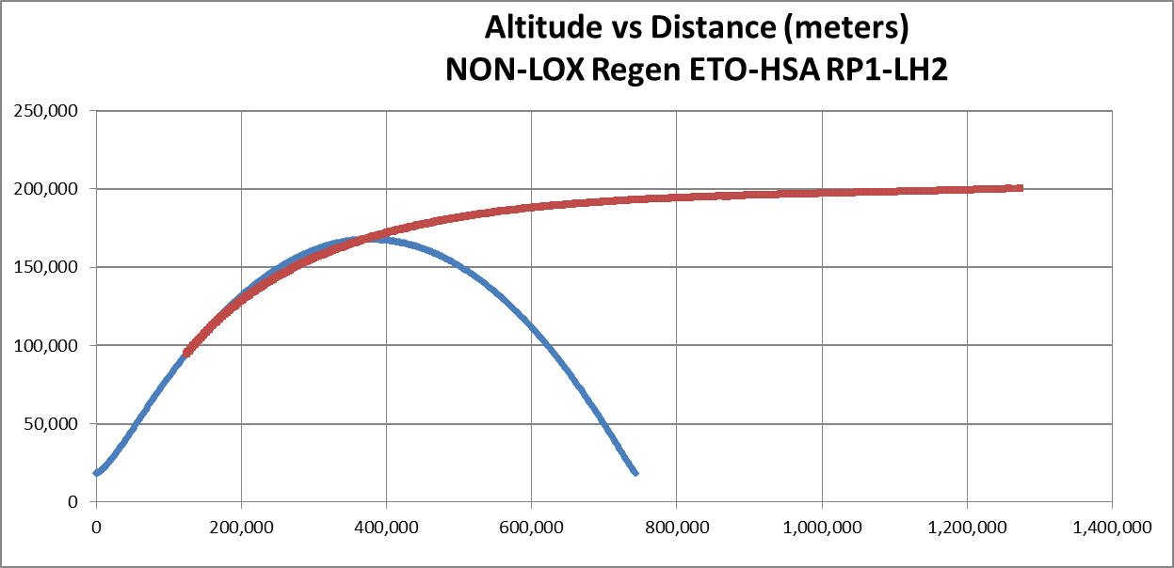
HSA Earth-to-Orbit Flight Profile
HSA ETO (BLUE) and Upper Stage (RED) flight altitude vs distance (meters)

Slide 10
Weights & Measures of 4 Versions

Slide 11
Data Comparison of 4 Versions

Slide 12
Sample Equations
Over 75,000 data points are needed per flight profile:
Temperature at altitude calculation for 1 data point
=IF(L25<12000,18-L25*0.006083,IF(L25<20000,-55,IF(L25<48000,-55+((L25-20000)*((10+55)/(48000-20000))),IF(L25<55000,10,IF(L25<83000,10+((L25-55000)*((-90-10)/(83000-55000))),IF(L25<95000,-90,IF(L25<145000,-90+((L25-95000)*((50+90)/(145000-95000))),50)))))))
Atmospheric pressure
=101325*EXP((-9.80665*0.0289644*L22)/(8.31432*300))
X-Force
=($F$3*($F$8+($F$8-$F$10)*(N23-$O$12)/$O$12)+($G$3*($G$8+($G$8-$G$10)*(N23-$O$12)/$O$12))*COS(K23/57.3)-B23)/D23
Multiple engines with thrust & Isp based upon ambient pressure
Y-Force
=(($F$3*($F$8+($F$8-$F$10)*(N23-$O$12)/$O$12)+($G$3*($G$8+($G$8-$G$10)*(N23-$O$12)/$O$12))*SIN(K23/57.3)+A23)/D23)
X-Velocity
=I22+9.81*F22*COS(K23/57.3)
Y-Velocity
=J22+9.81*F22*SIN(K23/57.3)-(9.81*(D22-A22)/D22*(1-I23/7600))

Slide 13
Summary
2nd in Series of 5 papers on Cheap Access to Space
Goal of this paper is to show the economic advantages of using an aircraft to launch an upper stage (and payload) at a very high altitude and at hypersonic speeds.
Since no such aircraft currently exists, we have presented economic justification for developing and operating a fleet of such aircraft
We conducted analysis of different versions of aircraft showing:
Flight range,
wing loading,
temperature, and
lift-to-drag ratio among other parameters to determine some figure of method on how well the HSA could function.
Results were encouraging enough that more research should be devoted to determine the optimum flight parameters for greatest range.
Please contact:
Douglas Thorpe, Kyrocketman@gmail.com – 606-723-2289
Please see: http://theUSAparty.com
Please see: http://spacepropulsion.org

